Slide 1
CYGNSS Operations: Managing a Constellation of 8 Micro-satellites in Low Earth Orbit
Jillian Redfern
Southwest Research Institute
Improving Space Operations Workshop

Slide 2
Outline
CYGNSS Mission
CYGNSS Operations
  Launch and Early Orbit
  Mission Planning
  Command and Control
  Data Processing
  Automation

Slide 3
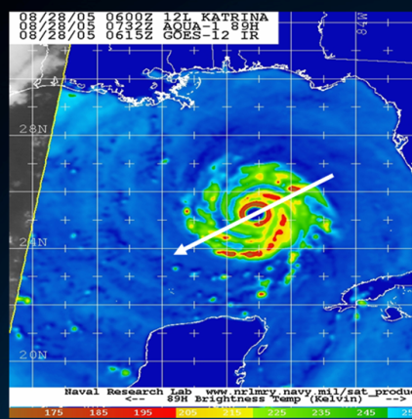
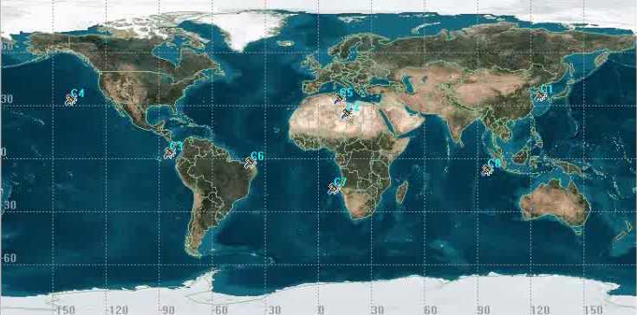
CYGNSS Science Advancements
Prior to CYGNSS:
  Track forecasts vs. intensity forecasts
  Current intensity measurements made “Hurricane Hunter” aircraft
  Current spacecraft measurements attenuated by rain
Eight satellites provide near gap-free coverage in 24 hours
  <30 kg each
Storm revisit time is less than 6 hours
Hurricane Hunter (WC-130J Aircraft) Measurement
CYGNSS 24-Hour Coverage Map
Notes:
So why CYGNSS? Over the years, hurricane track forecasts have improved significantly our ability to forecast the development of the storm (or intensity) has not. We know where the storm is going, we just don’t know what it’s going to do when it gets there. Examples: Katrina 10ft storm surge vs 30ft storm surge, Irene Cat4 vs Cat1.

Slide 4
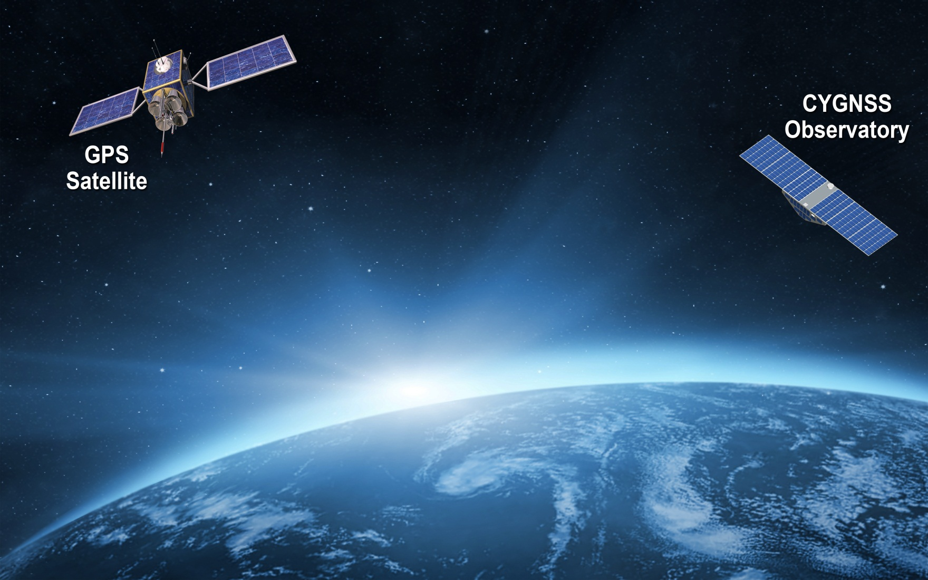

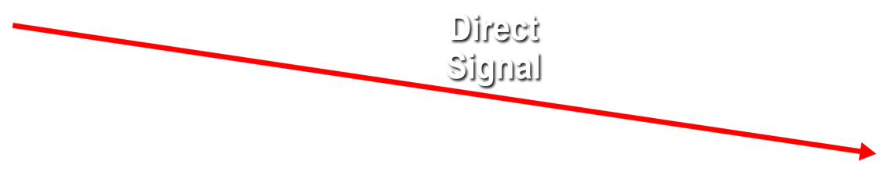


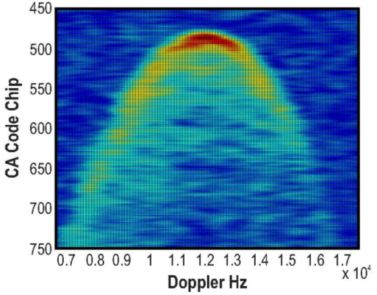

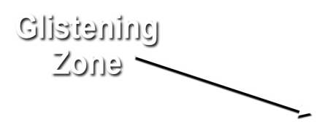
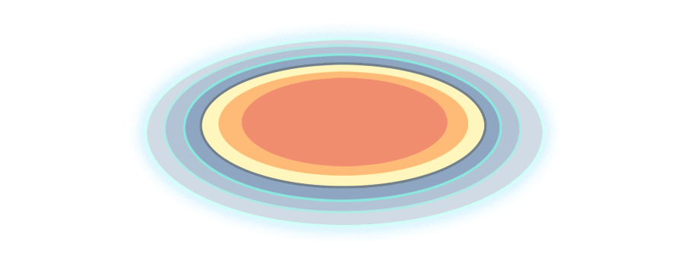
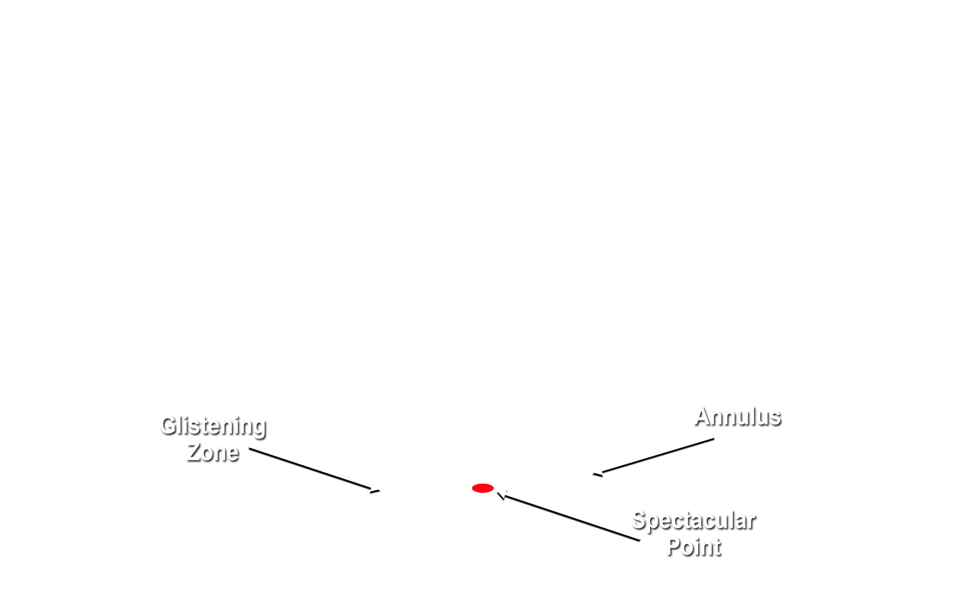
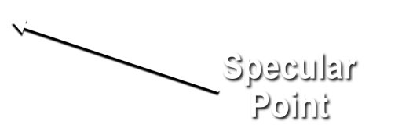
Notes:
How does CYGNSS measure intensity? CYGNSS is a proof of concept mission with 8 S/C measureing scattered GPS signals. Reflected signal scatters off the ocean surface -- received by earth facing array. Allows CYGNSS to be small since we don’t carry the signal generator, we use GPS since it’s already there. (Click) Ideal reflected signal (perfect ocean surface) -- mirror image of direct. (click) Glistening zone broadens from perfect surface (like a moon’s reflection on a rough water surface) to broad area given increase in surface wind speed. Direct GPS signal is used as a reference and is received by the antenna facing away from the earth. Scattered signal contains detailed information about wave speed. (click) Image produced from data from an earlier version of our instrument showing scattering cross-section. Wind speed can also be estimated from the shape of the scattering arc (the red and yellow regions).

Slide 5
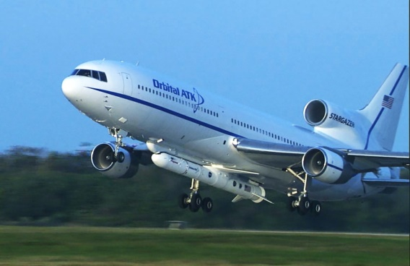
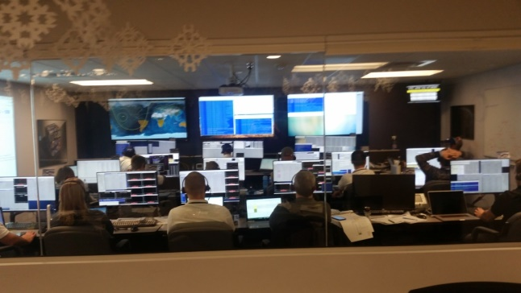
Launch and Early Operations
Launched December 15, 2016
  Second attempt
Two 13-hour shifts for initial two weeks
SwRI:
  First Built Satellite[s]
  First Mission Operations Center
December 2016 – Pegasus Rocket on L-1011

Slide 6
Commissioning
Original Plan: Nadir in 4 days
  Ended up being 1.5 months
Flexibility and Automation were key
  Unstaffed contacts
  Unique idle pattern with Automatic Playback even in Safe Mode
  Fault Detection and Correction Onboard
CYGNSS satellites are all slightly unique
  But on the whole they are extremely similar

Slide 7
Original Operations Concept
48 Hour Cadence Between contacts for each satellite
  Data downlink is Automatic
Nominal science data always recording once enabled unless a safing event occurs
No Propulsion
High Drag Maneuvers to Configure Constellation
Minimal daily tasking needed for Operations
Command Uploads at 1/week cadence with 2 week duration
One Science Pointing Mode: Nadir

Slide 8
Updated Operations Concept
24 Hour Cadence Between contacts for each satellite
  Data downlink is Automatic
High Drag Maneuvers only to avoid collision
Frequent activity updates from SOC for additional science (Active Storms, Flooding, Calibration)
Command Uploads at 1-3/week cadence with 2 week duration
One Science Pointing Mode: Nadir (with 90deg Yaw for Calibration)

Slide 9
Mission Planning
Special Science Requests
  Additional Data taken over Tropical Cyclones in concert with NOAA hurricane plane flights
MOC/Engineering Requests
  Radiation Effects
  Updating Onboard Macros
Flight Dynamics
  Collision Avoidance
  Constellation Configuration
Recovery After a Safing Event
  1-2 days; Additional 2-3 passes depending upon cause
  Ground-based automatic data downlink around the event

Slide 10
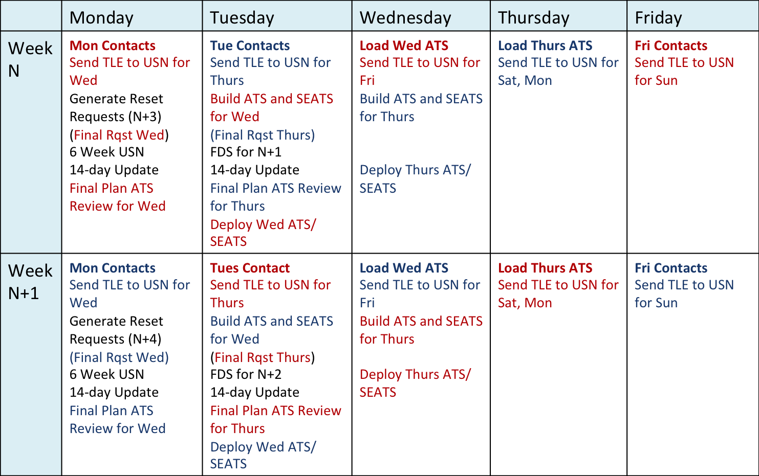
Mission Planning Calendar

Slide 11
Planning Information Flow

Slide 12
SIMPL

Slide 13
Command and Control
Galaxy
  Hammers Company Command and Telemetry System
  CCSDS Compliant Satellite Command/Control and Telemetry Processing System
  Fleet Context utilized by CYGNSS
    Common Database with differences incorporated
    Allows for simultaneous, single sourced contacts
  Telemetry Limit Checking in Real-Time and Post-Pass
USN (SSC Space US)
  Five Ground Stations in Hawaii, Australia, and Chile
    Allows for simultaneous contacts for better downlink coverage

Slide 14
Real-Time Data Flow

Slide 15
Data Processing

Slide 16
DP Procedure
Raw data files arrive from SSC
Delivered to Data Processing machine (one per satellite)
Python functions process data to find gaps and remove header data
CCSDS packet file is created for delivery to the SOC
Limit Violations Reports Created
ASCII Export of Crucial Data for Mission Planning and Flight Dynamics created
All Products Archived

Slide 17
Automation
Mercury
  Delivers, Tracks, and Archives all of the MOC products
  Start Programs
  Mission Planning Products, Command Uploads, Data Processing Products
RTS
  63 Real Time Sequences Onboard
  Fully Configurable
  Allows for single command execution to execute multiple timed commands
  Fault Detection and Correction
  Automatic Playback of Data during Contacts
Schedule Executor
  Executes Commands or STOL Procedures at a given time
Python Data Processing
  Finds gaps and automatically replays any missing block of data more than 0.5%

Slide 18
Additional Information
Data (Level 1, 2, 3): https://podaac.jpl.nasa.gov/CYGNSS
PI Institution: http://cygnss-michigan.org
NASA website: https://www.nasa.gov/cygnss

Slide 19
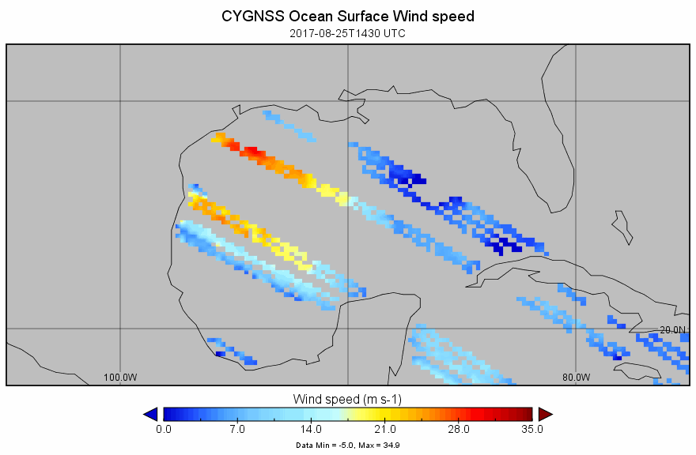
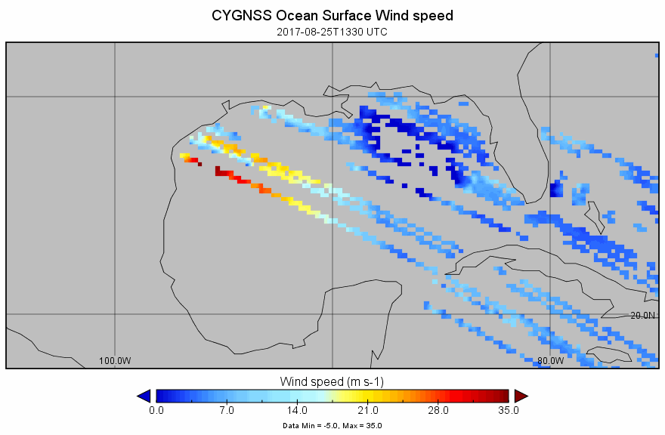
CYGNSS Data From Flight
(v1.1 calibration is still preliminary)

Slide 20
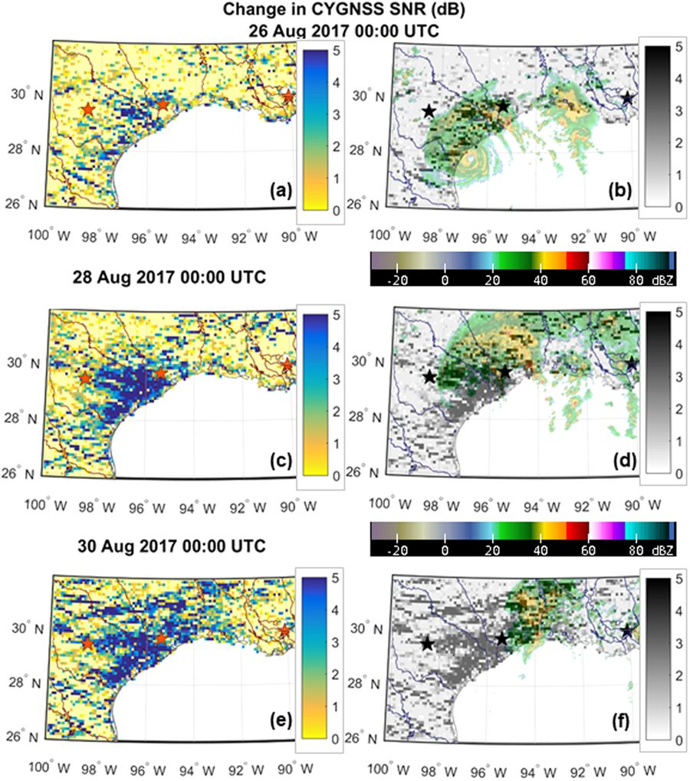
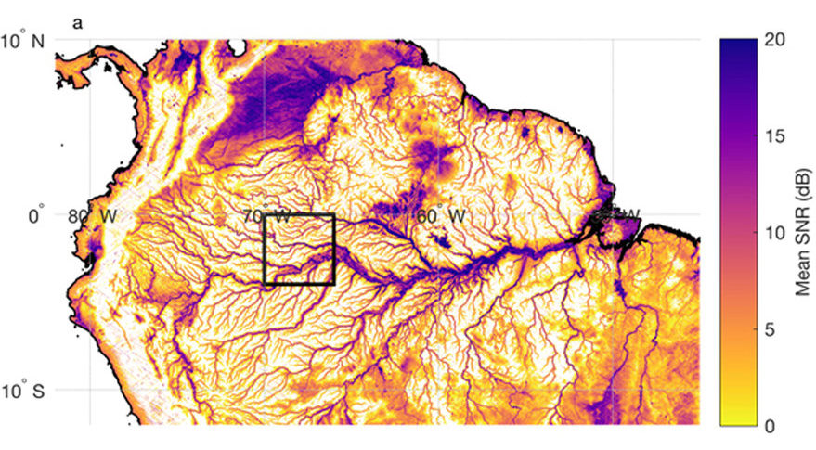
Soil Moisture Applications

Slide 21
Conclusions
All 8 satellites are operating nominally
Atlantic Hurricane Season keeps MOC and SOC busy from August – November
Flooding/Tides/Thaw-Cycle keeps the MOC and SOC budy the rest of the time

Slide 22
Any Questions?

